Slide 1

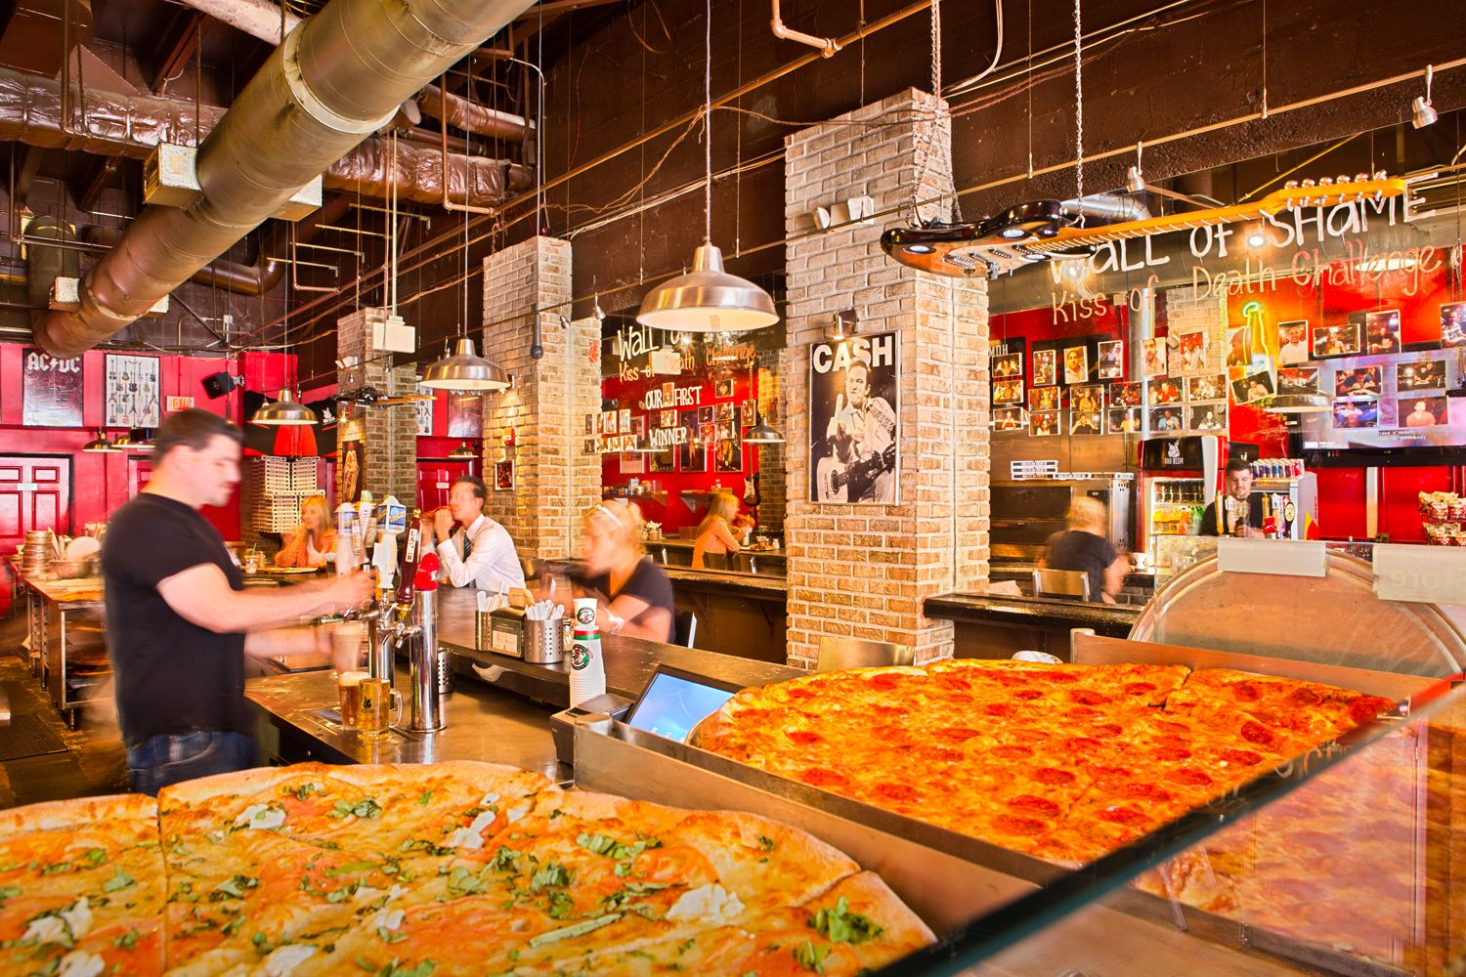
pizza sales Analysis
By CHARU CHANDNA
Mentorness

Slide 2
The goal of this SQL project is to analyze pizza sales data to gain insights into customer behavior, popular pizza types, sales trends, and overall performance. The analysis will be performed using four tables: order_details, orders, pizza_type, and pizza.
Project Overview

Slide 3

DATASET DETAILS
1. order_details
• order_details_id: Unique identifier for the order detail.
• order_id: Identifier linking to the orders table.
• pizza_id: Identifier linking to the pizza table.
• quantity: Number of pizzas ordered.
2. orders
• order_id: Unique identifier for the order.
• date: Date the order was placed.
• time: Time the order was placed.
3. pizza_type
• pizza_type_id: Unique identifier for the pizza type.
• name: Name of the pizza.
• category: Category of the pizza (e.g., vegetarian, meat, etc.).
• ingredients: List of ingredients used in the pizza.
4. pizza
• pizza_id: Unique identifier for the pizza.
• pizza_type_id: Identifier linking to the pizza_type table.
• size: Size of the pizza (e.g., small, medium, large).
• price: Price of the pizza.

Slide 4

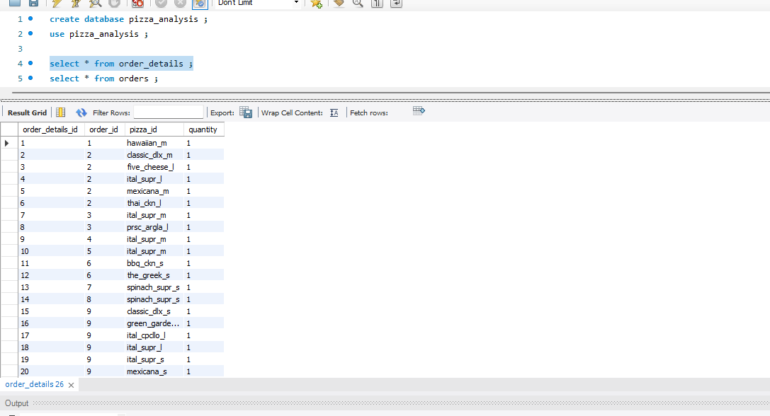
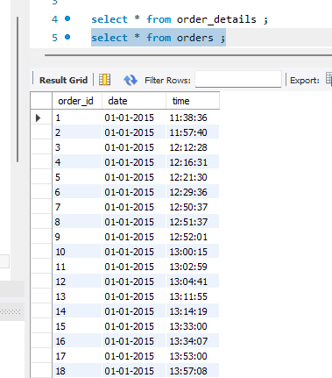
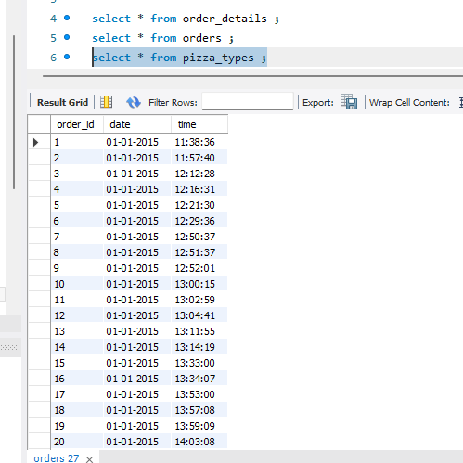
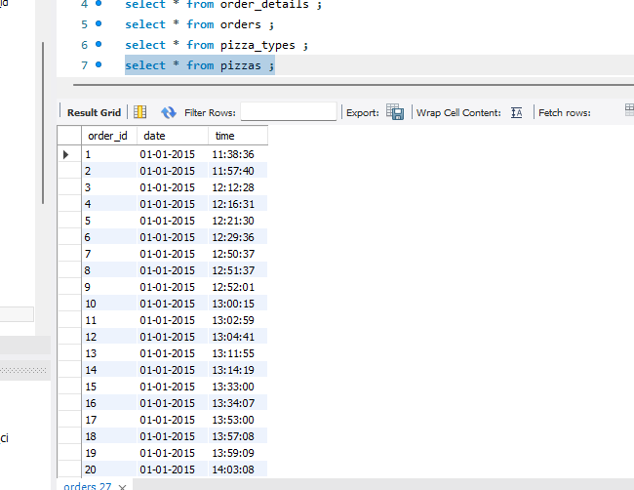
Dataset Overview

Slide 5
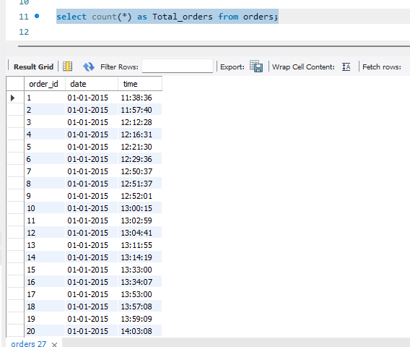
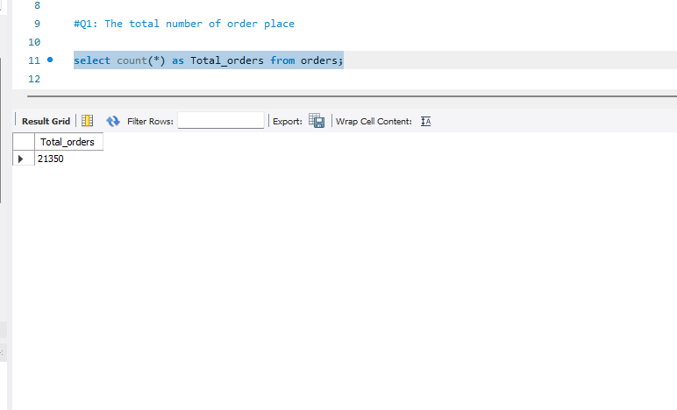
Q1: The total number of order place.

Slide 6
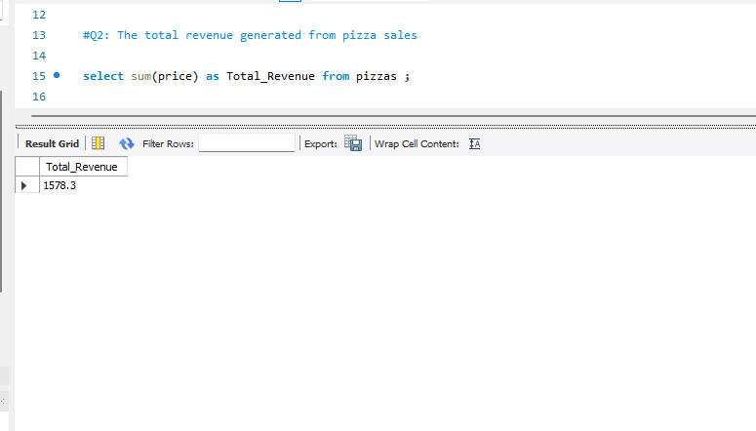
2. The total revenue generated from pizza sales

Slide 7
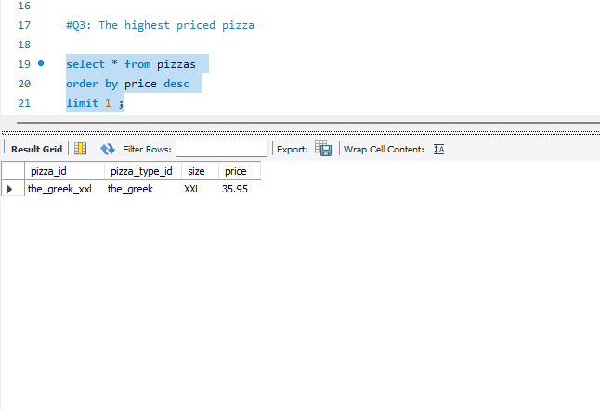
3. The highest priced pizza.

Slide 8
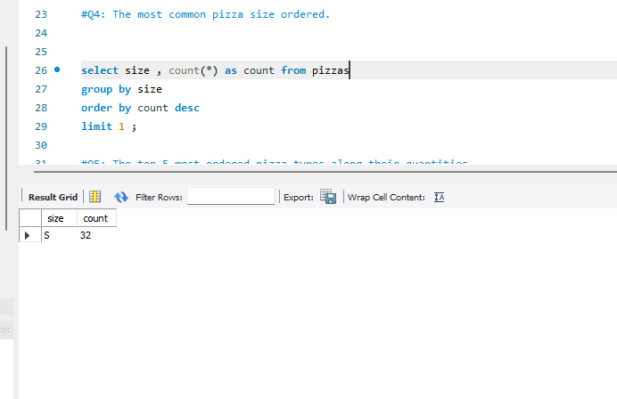
4.The most common pizza size ordered.

Slide 9
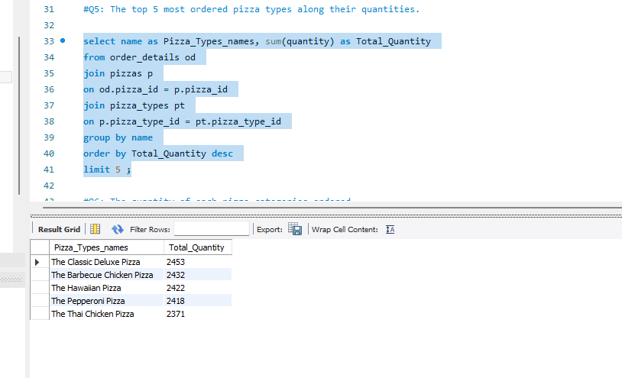
5. The top 5 most ordered pizza types along their quantities?

Slide 10
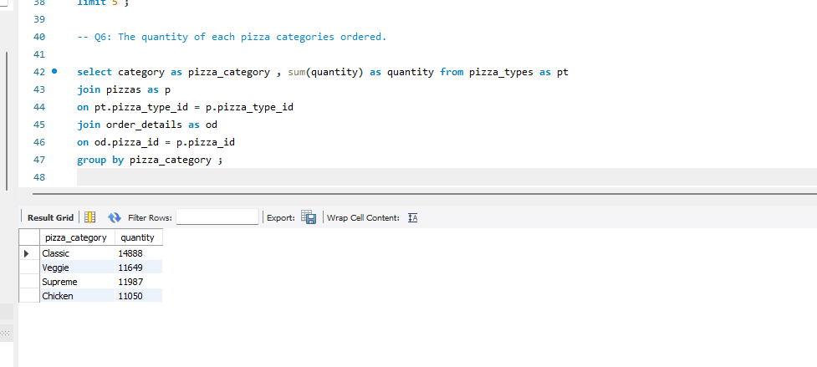
6. The quantity of each pizza categories ordered?

Slide 11
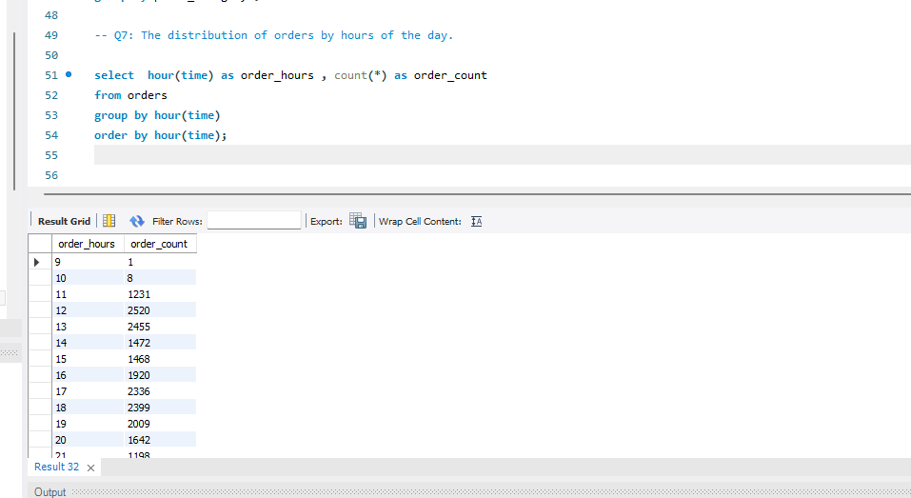
7. The distribution of orders by hours of the day?

Slide 12
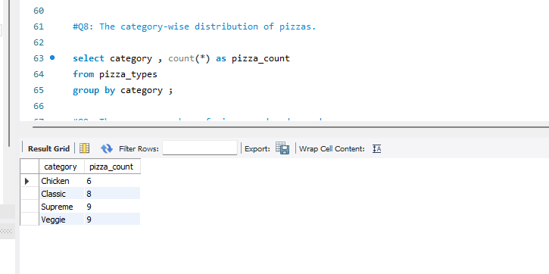
8. The category-wise distribution of pizzas?

Slide 13
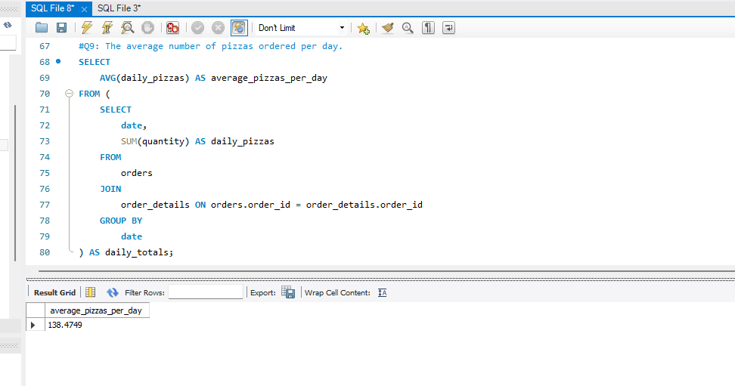
9. The average number of pizzas ordered per day?

Slide 14
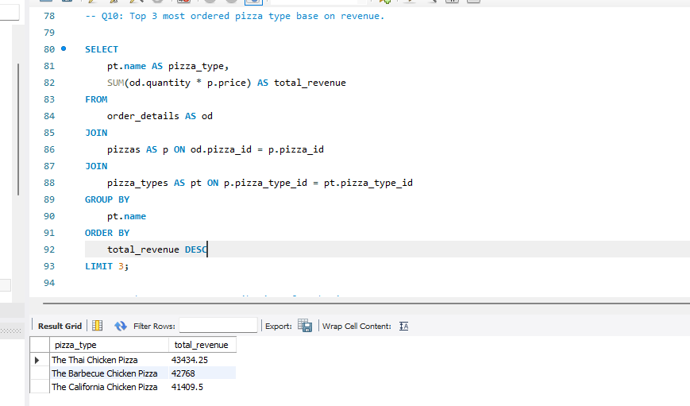
10. Top 3 most ordered pizza type base on revenue?

Slide 15
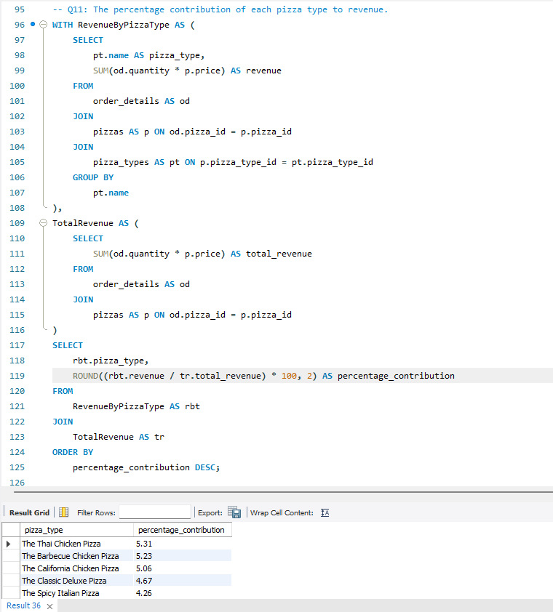
11. The percentage contribution of each pizza type to revenue.

Slide 16
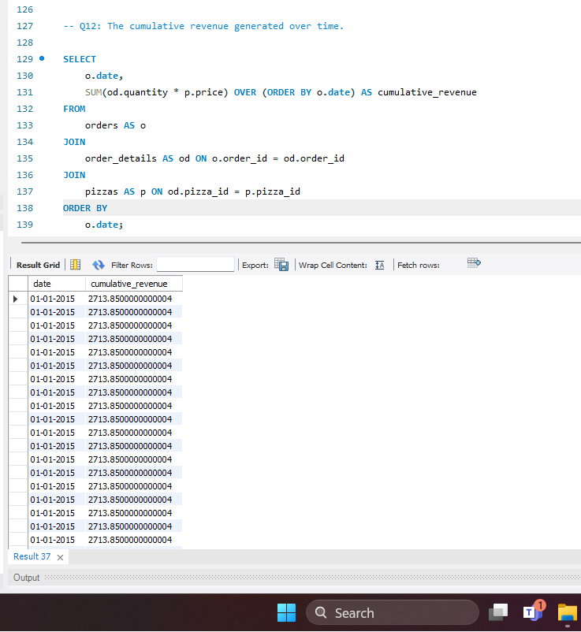
12. The cumulative revenue generated over time?

Slide 17
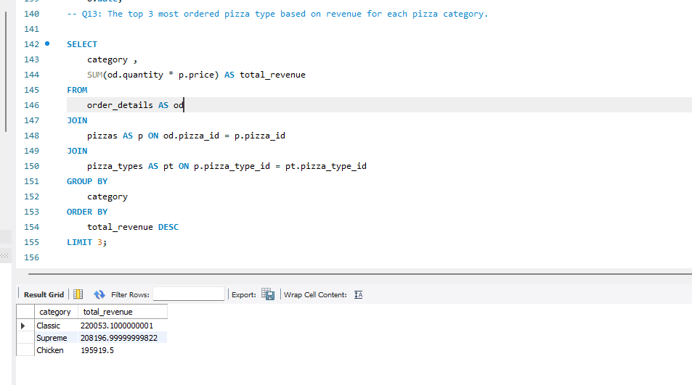
13. The top 3 most ordered pizza type based on revenue for each pizza category?

